Slide 1


North American Airports & Complex Network
Course Project of Complex Network.
Professors:
Dr. Chen
DR. Hu
Students:
Keyvan derakhshan nik
Huizhong liu

Slide 2

Importance of Airport Network
700 million passenger traveled through 20 busiest airport around the world. (https://www.virgin.com)
North America’s commercial airports are generating billions of dollars in annual activity, and supporting millions of good, stable jobs. (http://aci-na.org)

Slide 3
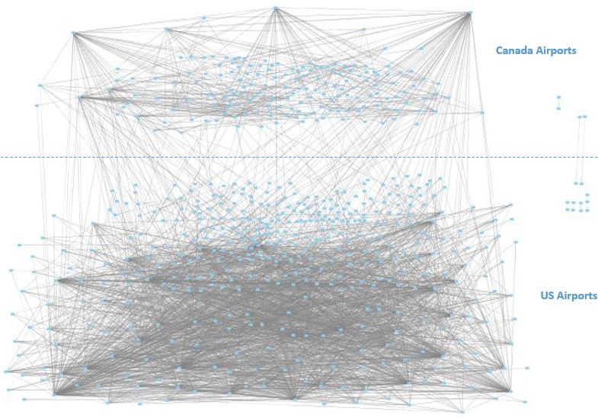
North America Airport Connected Graph
Number of nodes: 592
Number of links: 3052
Number of components: 8
Density: 0.017446380390542828
Ave clustering coefficient : 0.48204334679682737
Ave degree : 10.31081

Slide 4
Connected Airport Graph

Slide 5
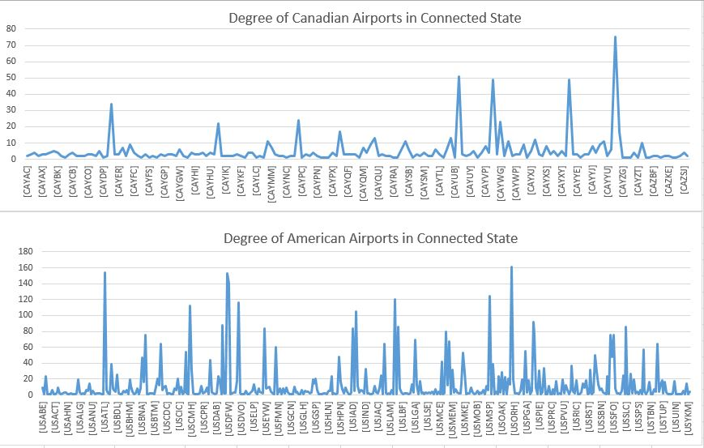
Degrees Distribution For Connected Graph
Rank | Airport | Degree
1 | USORD(Chicago) | 161
2 | USATL(Atlanta) | 154
…
19 | CAYYZ(Toronto) | 75
20 | USBOS(Boston) | 75
21 | USSEA(Seattle) | 75
22 | USSFO(SanFrancisco ) | 75
120 | CAYYT(St. John’s) | 11

Slide 6
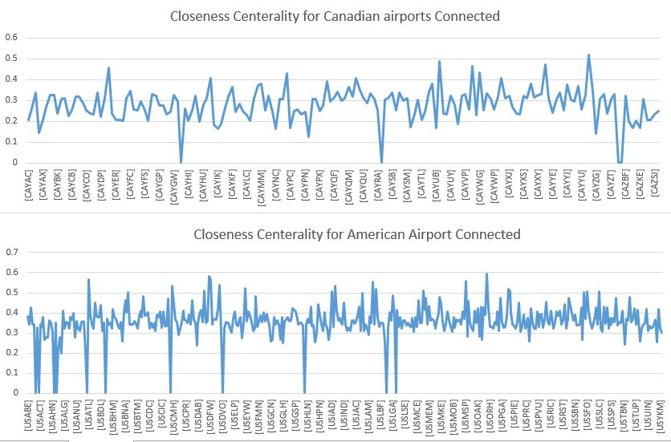
Closeness Centrality For Connected Graph
Rank | Airport | Closeness
1 | USORD(Chicago) | 0.592007
2 | USDEN(Denver) | 0.582588
…
13 | CAYYZ(Toronto) | 0.517738
174 | CAYYT(St.john’s) | 0.367867

Slide 7
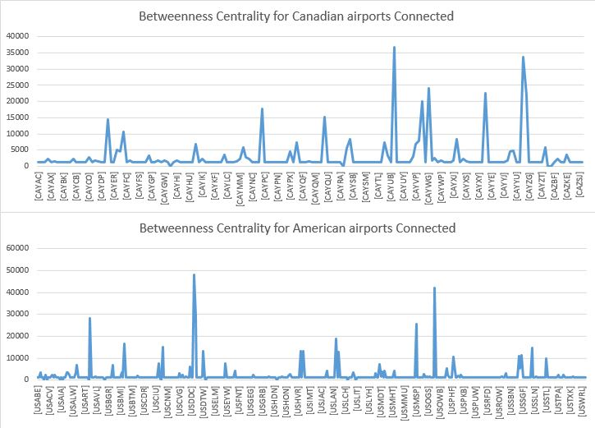
Betweenness Centrality For Connected Graph
Rank | Airport | Betweenness
1 | USDEN(Denver) | 48177.33425
2 | USORD(Chicago) | 42043.0673
3 | CAYUL(Montréal) | 36660.05137
48 | CAYYT(St.john’s) | 4738.30508

Slide 8
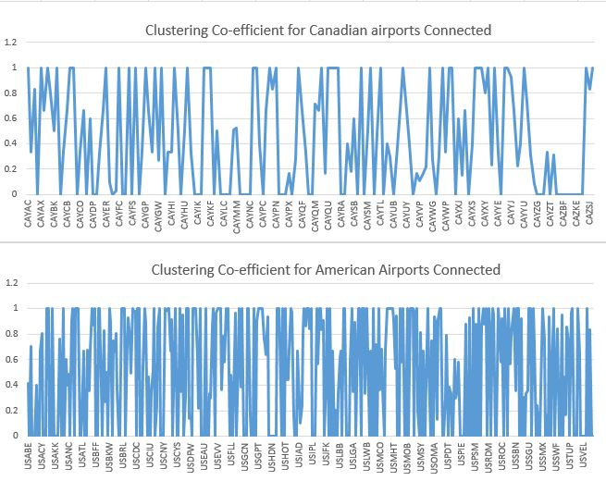
Clustering Co-efficient For Connected Graph
Number of Clustering Co-efficient =1 in Canada | 45
Number of Clustering Co-efficient =0 in Canada | 56
Number of Clustering Co-efficient =1 in US | 107
Number of Clustering Co-efficient =0 in Canada | 146

Slide 9
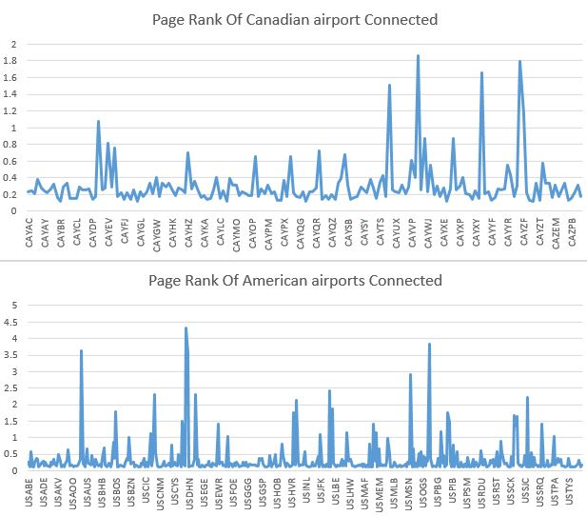
Page Ranks For Connected Graph
Rank | Airport | Page Rank
1 | USDEN(Denver) | 4.331499207
2 | USORD(Chicago) | 3.84651018
…
12 | CAYVR(Vancouver) | 1.866574987
13 | CAYYZ(Toronto) | 1.793256233
48 | CAYYT(St.john’s) | 0.442243

Slide 10
Disconnected Airport Graph

Slide 11
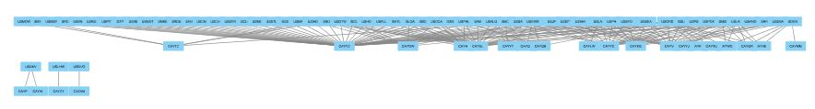
Border Edges Between US and Canada Which Assumed Are Removed
Rows | Airports | Number of deleted edges
1 | CAYYZ(Toronto) | 46
2 | CAYUL(Montréal) | 25
3 | CAYVR(Vancouver) | 18
4 | CAYYC(Calgary) | 17
5 | USORD(Chicago) | 13
…
 | CAYYT(St.john’s) | 2
Number of nodes: 81
Number of links: 170
Number of affected Components: 4

Slide 12
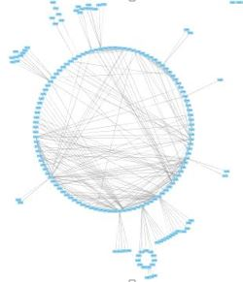
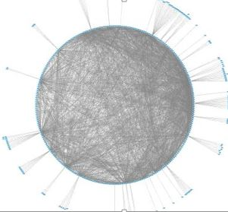
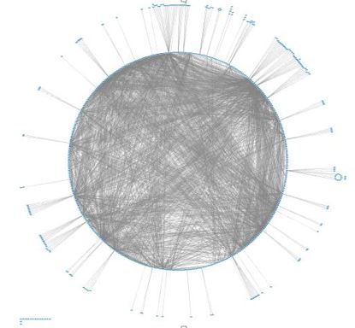
US and Canada Airport’s Disconnected Networks
Just Canada
Number of nodes: 172
Number of links: 370
Number of components: 3
Density:0.025159798721610227
Ave clustering coefficient : 0.43987601150772704
Ave degree : 4.30232558139534
Just US
Number of nodes: 414
Number of links: 2512
Number of components: 5
Density: 0.02938320992853049
Ave clustering coefficient : 0.49931501299812453
Ave degree : 12.1352657
All Connected
Number of nodes: 592
Number of links: 3052
Number of components: 8
Density: 0.017446380390542828
Ave clustering coefficient : 0.48204334679682737
Ave degree : 10.31081

Slide 13
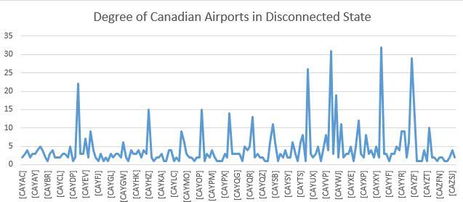
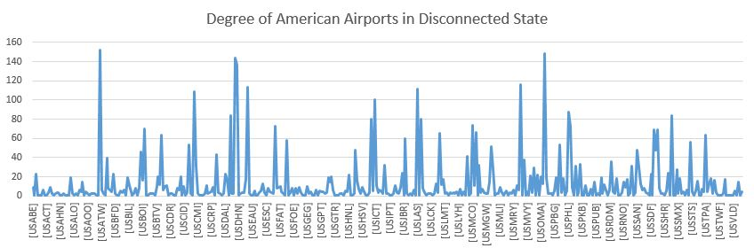
Degrees Distribution For Disconnected Graph
Rank | Airport | Degree
 | USATL(Atlanta) | 152
 | USORD(Chicago) | 148
…
 | CAYYC(Calgary) | 32
 | CAYVR(Vancouver) | 31
 | CAYYT(St.john’s) | 9

Slide 14
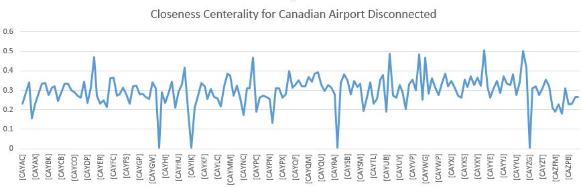
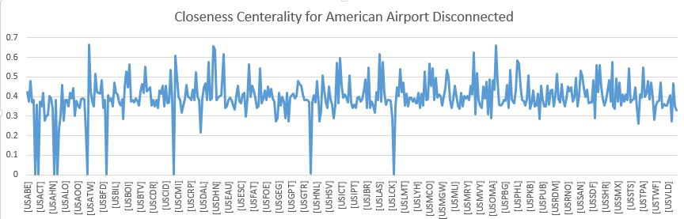
Closeness Centrality For Disconnected Graph
Rank | Airport | Closeness
 | USATL(Atlanta) | 0.663640032
 | USORD(Chicago) | 0.661016949
 | USDEN(Denver) | 0.656981437
…
 | CAYYC(Calgary) | 0.50561125
 | CAYYZ(Toronto) | 0.50214425
 | CAYYT(St.john’s) | 0.384

Slide 15
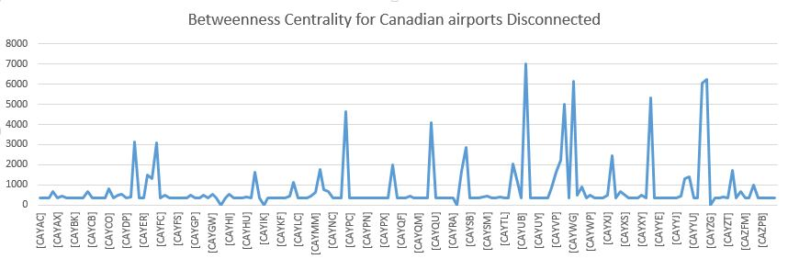
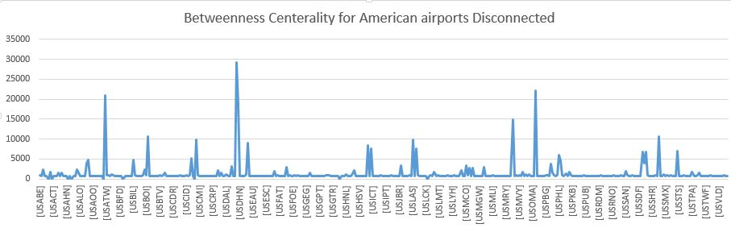
Betweenness Centrality For Disconnected Graph
Rank | Airport | Betweenness
 | USDEN(Denver) | 29262.87307
 | USORD(Chicago) | 22112.2596
…
 | CAYUL(Montréal) | 7022.245061
 | CAYYT(St.john’s) | 1417.4412

Slide 16
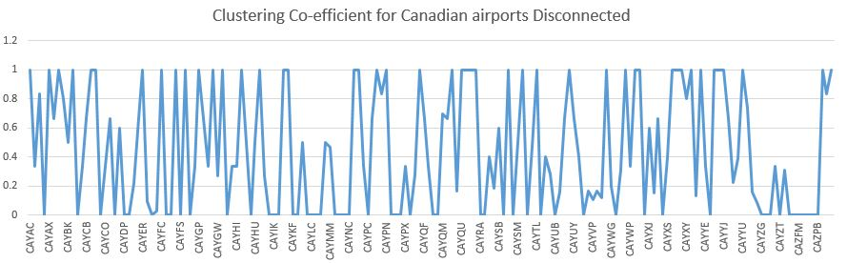
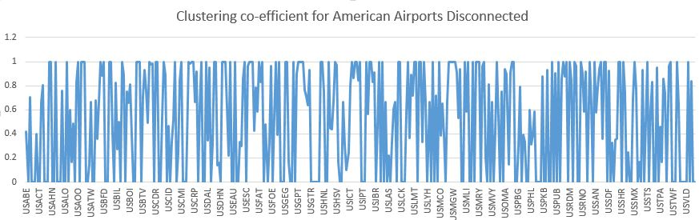
Clustering Co-efficient For Disconnected Graph
Number of Clustering Co-efficient =1 in Canada | 45
Number of Clustering Co-efficient =0 in Canada | 55
Number of Clustering Co-efficient =1 in US | 106
Number of Clustering Co-efficient =0 in Canada | 144

Slide 17
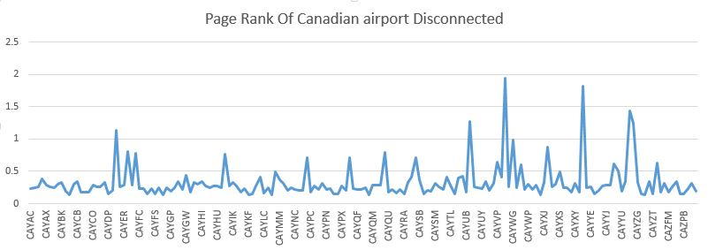
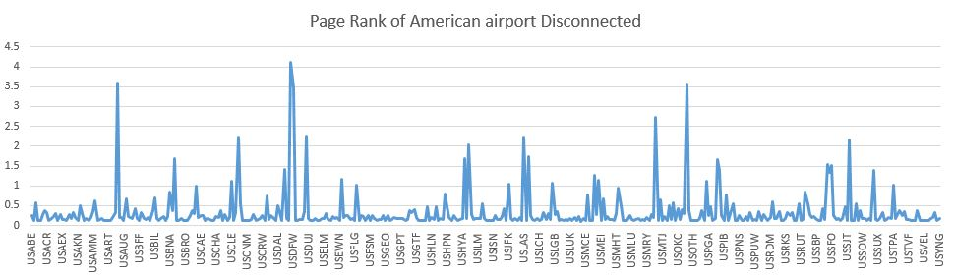
Page Ranks For Connected Graph
Rank | Airport | Page Rank
 | USDEN(Denver) | 4.121449052
 | USATL(Atlanta) | 3.597149773
 | USORD(Chicago) | 3.535110628
..
 | CAYVR(Vancouver) | 1.948732356
 | CAYYC(Calgary) | 1.827781985
 | CAYYT(St.john’s) | 0.50698

Slide 18
Comparison

Slide 19
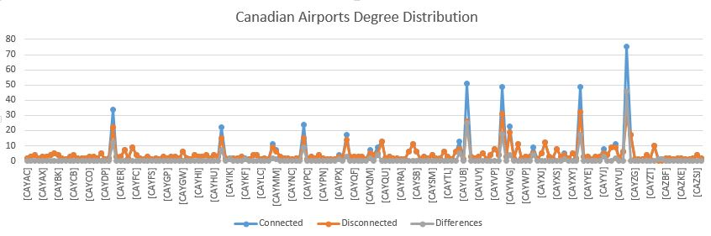
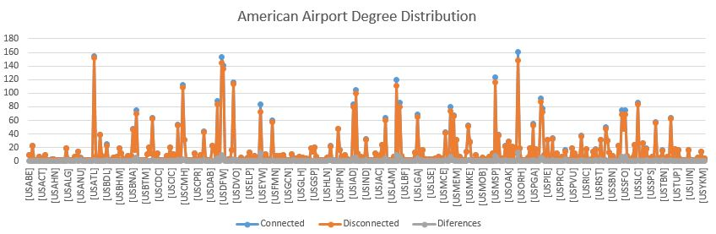
Comparison Degree Distribution
Airport code | City name | difference
CAYYZ | Toronto | 46(+158%)
CAYUL | Montréal | +25(+96%)
CAYVR | Vancouver | +18(+58%)
CAYYC | Calgary | +17(+53%)
USORD | Chicago | +13(+8%)

Slide 20
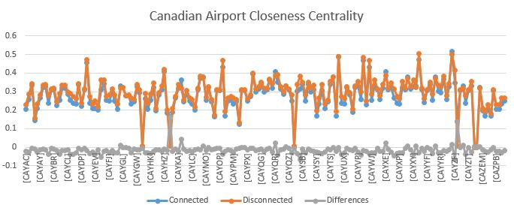
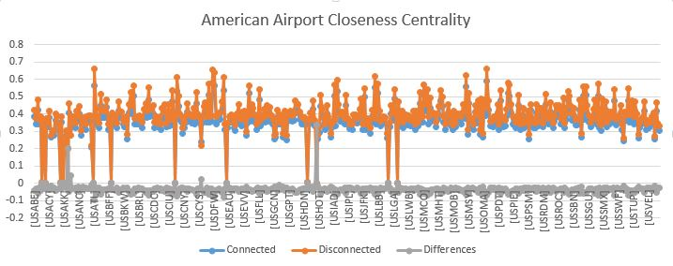
Comparison Closeness Centrality
Airport code | City name | difference
CAYIK | Ivujivik, QC | +2726.23%
CAYZG | Salluit, QC | +2309.6%
CAYKF | Breslau, ON | +13.63%
CAYQR | Regina, SK | +6%

Slide 21
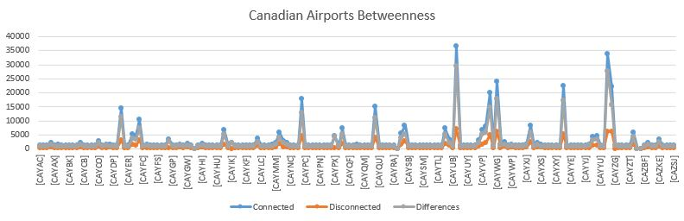
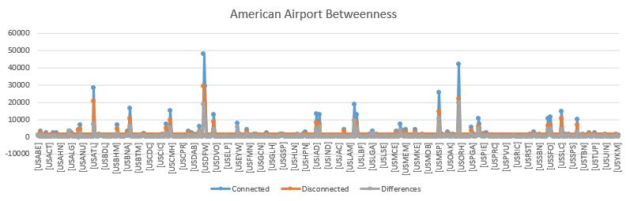
Comparison Betweenness Centrality
CAYIK …. | Ivujivik, QC | +76666%
CAYYZ | Toronto | +456%
CAYUL | Montréal | +422%
CAYEG | Edmonton | +364%
CAYVP | Kuujjuaq, QC | +325%
CAYYC …. | Calgary | +323%
USLAS | Las Vegas | +92%
USORD | Chicago | +90%

Slide 22
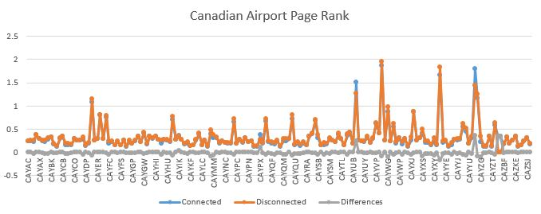
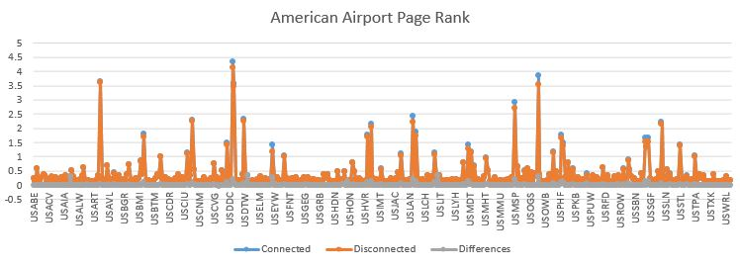
Comparison Page Rank
Airport code | City name | difference
CAYYZ | Toronto | +24.3%
CAYUL | Montréal | +18.7%
USMCO | Orlando | +10.6%
USLAS | Las Vegas | +9.2%

Slide 23
Conclusion

Slide 24
Conclusion
1. based on their rank of centrality, degree and pageRank:
the most important airport in CA airline system:
YYZ(Toronto), YVR(Vancouver) , YYC(Calgary), YUL(Montréal), YEG(Edmonton),
the most import airport in US airline system:
ATL(Atlanta),ORD(Chicago), DEN(Denver), DFW(Dallas),MSP(Minnesota)
2. Without connected with US airline system, most of CA airport will loose huge amount of value no matter centrality, pageRank, degree.
3. Without connected with CA airline system, the centrality , pageRank’s value of most of US airport will not have a obvious difference.
4. US airline system is much more robust than CA airline system, based on the average clustering coefficient and density.

Slide 25

Thank You

